Slide 1
Statistics 101
Tomas Karpati MD tc.datascience@gmail.com
054-2002430

Slide 2
Statistics
Statistics is a branch of mathematics dealing with the collection, organization, analysis, interpretation and presentation of data.
In data science need two essential things:
Data: is our raw material
Statistics: is the main tool for transforming the raw data and to convert it into gold (predictions).

Slide 3
Central Tendency Measures
Central tendency (CT) is the most common value on a series of data.
There are many types of CT measures, but the most adequate measure depends on the data type and on the distribution of the data values.
Central Tendency
Mode
Median
Mean

Slide 4
Central Tendency Measures
Mode (or moda) is the most common or frequent value in the data set.
It could be used on any data type, but is the unique CT statistic that could be used in nominal data.
Central Tendency
Mode
Median
The Most Used Programming Languages in Data Science:
Python 1,508
R 1,412
SQL 911
Java 644
Scala 320
השמות הפופולריים בישראל
נעה (בת) 1,440
נועם (בן) 1,414
דוד (בן) 1,400
תמר (בת) 1,323
אורי (בן) 1,320
Mean

Slide 5
Central Tendency Measures
Central Tendency
Medium
High
Medium
Medium
Low
Medium
High
Medium
High
Medium
Low
Medium
Medium
Low
High
Medium
Low
Low
Low
Low
Medium
Medium
Medium
Medium
Medium
Medium
Medium
Medium
Medium
High
High
High
Mode
Value Frequency
Medium 9
Low 4
High 3
Median
Mode = Medium
Mean

Slide 6
Central Tendency Measures
Central Tendency
The median is the value separating the higher half from the lower half of a data variable.
It could be used for any continuous or ordinal data types.
Mode
Median
Mean

Slide 7
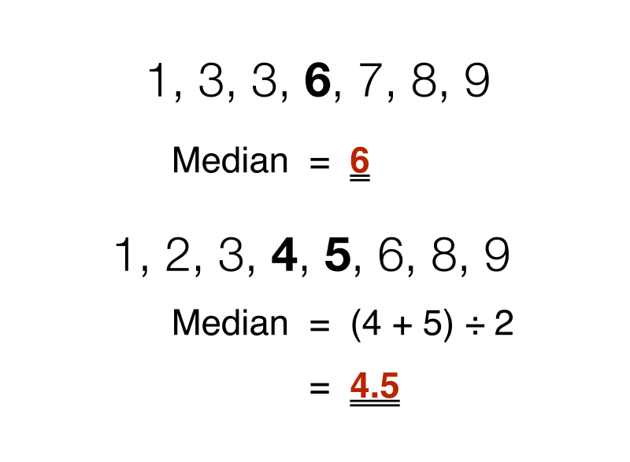
Central Tendency Measures
Central Tendency
Mode
Median
Mean

Slide 8

Central Tendency Measures
Mean (Arithmetic mean, Average) is the sum of the values of all the observations divided by the total number of observations. It is sometimes represented with the greek character µ.
Central Tendency
Mode
Median
Mean

Slide 9
Deviation Measures
Deviation Measures refers to the degree of dispersion (variability or spread) of the data around a central measure.
This deviation depends of the data distribution type.
For each data type different deviation measures are recommended.

Slide 10
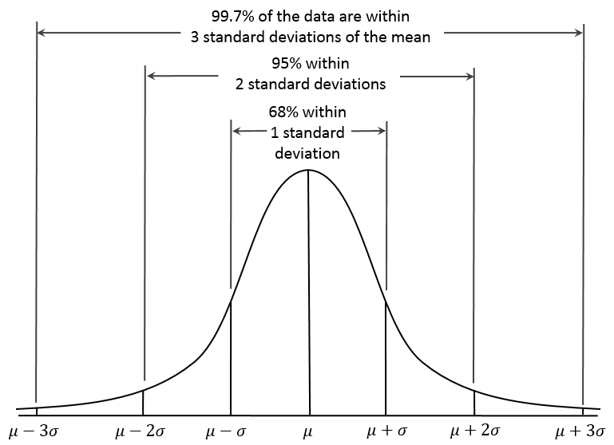
Gaussian or Normal Distribution
Data Distributions

Slide 11
Deviation Measures
Range
Range is the size of the smallest interval which contains all the data.
Range = max(var1) - min(var1)
The range is useful for describing ordinal data, but can be also used for describe continuous data types.
Most of the time we write the range as its parts (Xmax - Xmin)
IQR
Variance
SD
SE
CI
Notes:
רוחב הפיזור של הנתונים ביחס למדדי המרכוז

Slide 12
Deviation Measures
Range
Interquartile range (IQR), also called the midspread or H-spread, is a measure of statistical dispersion, being equal to the difference between 75th and 25th percentiles, or between upper Q3 and lower quartiles Q1. Q2 (50th percentile) is the median.
IQR
Variance
SD
SE
CI

Slide 13

Deviation Measures
Range
Variance: Is the sum of the square of the difference between a variable and its mean. The variable must be random.
The variance measures how far each number in the set is from the mean. It is the basis to many statistical tests.
IQR
Variance
SD
SE
CI

Slide 14
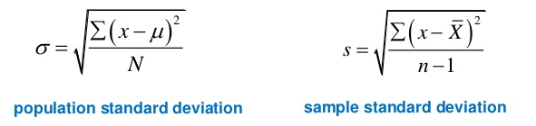
Deviation Measures
Range
Standard Deviation (SD, σ or s) is a measure that is used to quantify the amount of variation or dispersion of a set of data values. It is calculated as:
IQR
Variance
SD
SE
CI

Slide 15
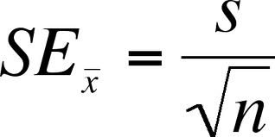
Deviation Measures
Range
Standard error of the mean is a measure of the dispersion of sample means around the population mean.
IQR
Variance
SD
SE
CI

Slide 16
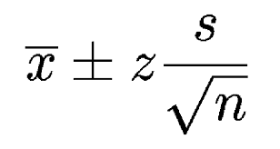
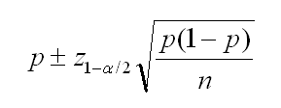
Deviation Measures
Range
Confidence Interval represents the frequency of possible intervals that contain the true value of the unknown population parameter. It is determined depending on the confidence level (𝑧) we want to achieve.
IQR
Variance
SD
Confidence level | Critical value (𝑧)
90% | 1.645
95% | 1.960
99% | 2.576
CI of the mean
CI of a proportion
SE
CI

Slide 17
The p-value
The p-value is the degree of confidence we have that a result we get is real and is not the result of chance.
Common cutoffs used in p-values are:
p<0.05 Is the standardly used value. Indicates we have a 95% confidence
p <0.01 Indicates we have a 99% of confidence
p <0.001 Strongly suggests that the results are not due to chance (99.9% confidence)
p-values are related to the confidence intervals.

Slide 18
Parametric vs Nonparametric
Parametric statistics is a branch of statistics which assumes that sample data comes from a population that follows a probability distribution based on a fixed set of parameters. Parametric test have more power.
Nonparametric statistics is based on either being distribution-free or having a specified distribution but with the distribution's parameters unspecified.
Nonparametric test are more robust.

Slide 19
Association Measures
Correlation or Association is the relationship between two variables.
When causality is present, a high correlation exist.
However, a high correlation is not imply causality
Parametric correlation
The variables have to be random, and their distribution must be normal
Non-parametric correlation
In cases when randomness and normality are violated, we use non-parametric correlation

Slide 20
Association Measures
Parametric
Pearson's product-moment coefficient
Non-parametric
Rank correlation coefficients
Spearman Correlation
Kendall Tau Correlation
Correlation matrices

Slide 21

Correlation Coefficients
Pearson's product-moment coefficient: is the covariance of two variables divided by the product of their standard deviation.
The result is a number between -1 and 1. Zero (0) represent no correlation at all, -1 or 1 represent a perfect correlation. The minus sign represents the direction of the relationship.
The p-value indicates the confidence we have that the correlation really exists.

Slide 22

Correlation Coefficients
Spearman (rho) correaltion coefficient: is the covariance of two ranged variables divided by the product of the standard deviation of the rank variables.
Before the calculation we have to order each of the variables in ascending order and assign them rank value. If two or more values appear more than once we assign to then the mean of the consecutive positions.

Slide 23
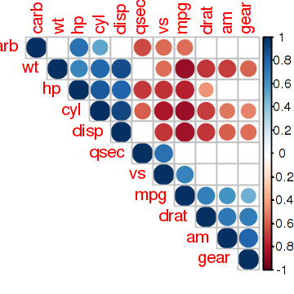
Correlation Matrix

Slide 24
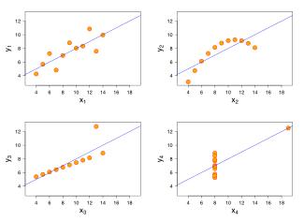
Correlation
Does high correlation imply linearity or that the vectors are very similar ?
Four sets of data with the same correlation of 0.816

Slide 25
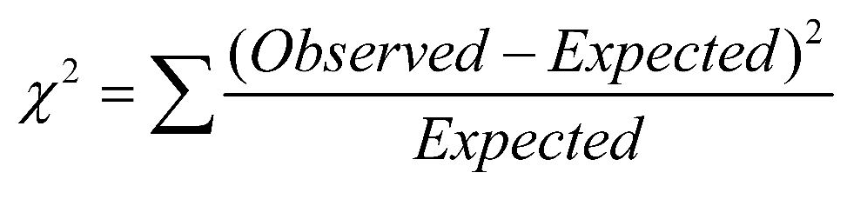
Comparison
Chi-Square (𝟀²): is used to determine whether there is a significant difference between the expected frequencies and the observed frequencies in one or more categories. In 1900, Pearson published a paper on the χ2 test which is considered to be one of the foundations of modern statistics. In this paper, Pearson investigated the test of goodness of fit.

Slide 26

Comparison
Example:
Each package of Milk Chocolate M&M's should contain 24% blue, 14% brown, 16% green, 20% orange, 13% red, and 14% yellow M&M's. To check if this is true, 48 packages of M&M Milk Chocolate 1, containing a total of 2620 M&M’s
Chi-Square (𝟀²) = 50.835, df = 5, p-value < 0.001
Color | Expected % | Observed n | Observed %
Blue | 24% | 481 | 18.36%
Brown | 14% | 371 | 14.16%
Green | 16% | 483 | 18.44%
Orange | 20% | 544 | 20.76%
Red | 13% | 372 | 14.20%
Yellow | 14% | 369 | 14.08%
Total | 100% | 2620 | 100%

Slide 27
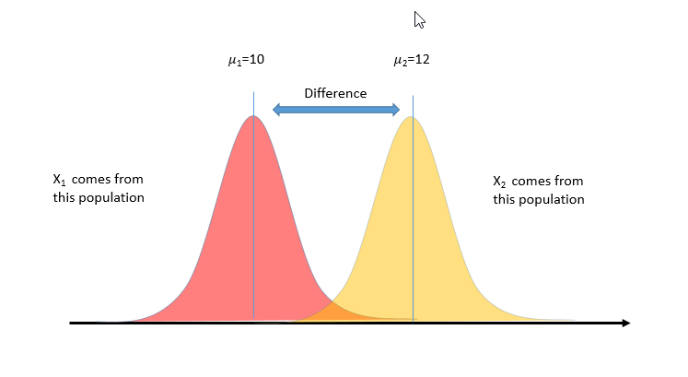


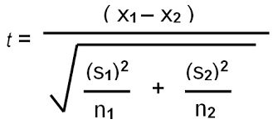
Comparison
Student’s t-test: created by William Gosset, is used to determine if two sets of data are significantly different from each other. It assumes a normal distribution.
Signal
Noise
Notes:
שעורה

Slide 28
Comparison
Student’s t-test
Independent (unpaired) Samples: when two group of observations are compared to check if they come from the same population.
A group of patients are sampled into two groups: treatment and controls
Paired Samples: each observation pair is matched.
The same individuals are measured before and after an intervention (pre-test/post-test)
Notes:
שעורה

Slide 29
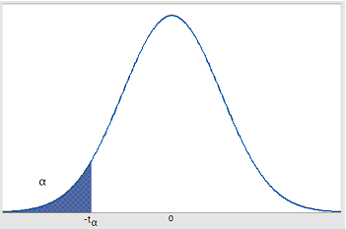
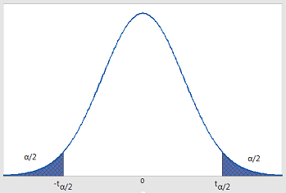
Comparison
Student’s t-test
One sided t-test: The hypothesis is that one group is smaller/ greater than the other
(H₀= 𝜇₁ <= 𝜇₂)
Two sided t-test: The hypothesis is that both groups are different
H₀ = 𝜇₁ ≠ 𝜇₂
Notes:
שעורה

Slide 30
Comparison
Non-Parametric Statistics
Sign test
Wilcoxon signed rank test
Mann-Whitney test
Tests based on counting the signs of the differences between the values of two datasets
Notes:
שעורה

Slide 31
Parametric vs Nonparametric
Statistical | Parametric tests (means) | Nonparametric tests (medians)
Comparison | -- | Chi-Square test (ordinal)
Difference | 1-sample (dependent) t test | 1-sample Sign test, 1-sample Wilcoxon
 | 2-sample (independent) t test | Mann-Whitney test
 | One-Way ANOVA | Kruskal-Wallis, Mood’s median test
 | One-Way repeated measurements ANOVA | Friedman’s test
Relationship | Pearson correlation | Spearman’s correlation

Slide 32
Distributions
A data distribution represents the frequency of the values of a variable ordered in an ascending order.
There are mathematical functions (density functions) that try to represent the most commonly occuring distributions. Those functions are used to model variables behaviours and are used as the base of predictive models.

Slide 33
Data Distributions
Gaussian
Gaussian or Normal distribution is the most commonly used continuous probability distribution. It is also known as the bell curve. Its most important feature is that its center is represented by the mean and it is symmetrical on both sides beside the mean.
t (Student)
Binomial
Gamma
Poisson

Slide 34
Data Distributions
Gaussian
t (Student)
Binomial
Gamma
Poisson

Slide 35
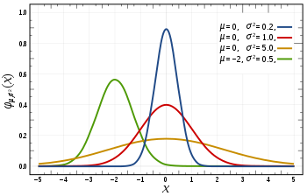
Data Distributions
Gaussian
t (Student)
Binomial
Gamma
Poisson

Slide 36
Data Distributions
Student's t-distribution is a probability distribution that is used to estimate population parameters when the sample size is small and/or when the population variance is unknown.
The particular form of the t distribution is determined by its degrees of freedom. The degrees of freedom (df) refers to the number of independent observations in a set of data.
Gaussian
t (Student)
Binomial
Gamma
Poisson

Slide 37
Data Distributions
Gaussian
Properties of the t-distribution
The mean of the distribution is equal to 0 .
The variance is equal to v / ( v - 2 ), where v is the degrees of freedom and v > 2.
The variance is always greater than 1, although it is close to 1 when there are many degrees of freedom.
With infinite degrees of freedom, the t distribution is the same as the standard normal distribution.
t (Student)
Binomial
Gamma
Poisson

Slide 38
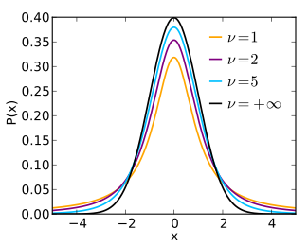
Data Distributions
Gaussian
t (Student)
Binomial
Gamma
Poisson

Slide 39
Data Distributions
Binomial (Bernoulli) distribution is frequently used to model the number of successes (P) in a sample of size n drawn with replacement from a population of size N. In the binomial distribution there must be two only possible outcomes.
The binomial distribution has the following properties:
The mean of the distribution (μx) is equal to (n*P)
The variance (σ2x) is (n*P*(1-P))
The standard deviation (σx) is √(σ2x)
Gaussian
t (Student)
Binomial
Gamma
Poisson

Slide 40
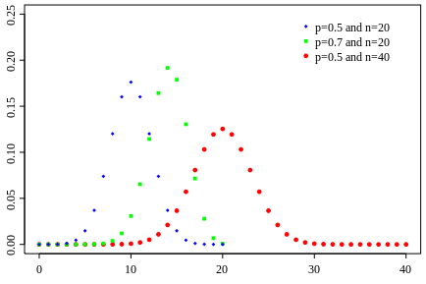
Data Distributions
Gaussian
t (Student)
Binomial
Gamma
Poisson

Slide 41
Data Distributions
Gaussian
Gamma distribution is a two-parameter family of right-skewed, continuous probability distributions. It is widely used to model physical quantities that take positive values.
Special cases of the gamma distribution are: Chi-square, exponential and Erlang distributions
t (Student)
Binomial
Gamma
Poisson

Slide 42
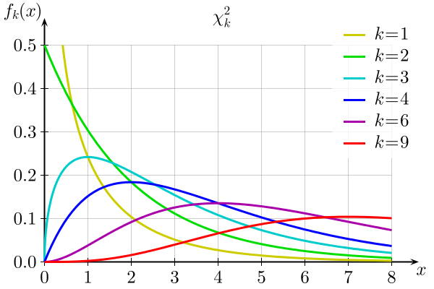
Data Distributions
Chi-square (𝟀²) distribution
* k = degrees of freedom
Gaussian
t (Student)
Binomial
Gamma
Poisson

Slide 43
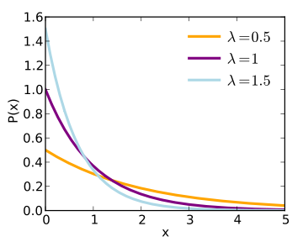
Data Distributions
Gaussian
Exponential distribution
t (Student)
Binomial
Gamma
Poisson

Slide 44
Data Distributions
Gaussian
A Poisson distribution is the probability distribution that results from a Poisson experiment, which has the following properties:
The experiment results in outcomes that can be classified as successes or failures.
The average number of successes (μ) that occurs in a specified region is known.
The probability that a success will occur is proportional to the size of the region.
The probability that a success will occur in an extremely small region is virtually zero.
t (Student)
Binomial
Gamma
Poisson

Slide 45
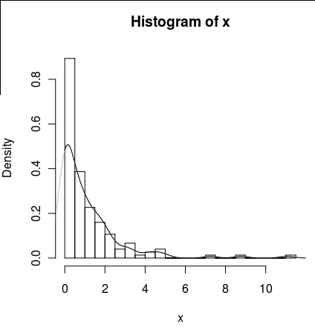
Data Distributions
Gaussian
A special case of Poisson distribution is the called zero-inflated distribution where the most frequent observation is zero.
t (Student)
Binomial
Gamma
Poisson
Notes:
Uniform distribution

